Slide 1
Introduction to the Stove Testing Toolbox It is offered as an alternative to the current IWA and its single prescribed task for all stoves as means of determining performance.
The Stove Testing Toolbox consists of set of validated test methods, definitions, metrics, reporting and consolidation protocols permitting a laboratory to conduct socially and scientifically valid tests that are culturally appropriate for any target community – emphasis on comparative performance.
First, however, it is important to examine the current test method (under development) in order to provide some perspective on the IWA Tiers and the Stove Performance Inventory rankings.

Slide 2
The WBT 4.2.1 analysed on a First Principles basis Why analyse this version of the WBT? Because it is referenced by the GACC and indirectly by the IWA.
Our purpose:
To establish the scientific basis of test methods before making a commitment to any particular protocol or set of metrics
Problems:
The WBT 4.2.1 is still a work in progress with significant unresolved conceptual, mathematical and procedural issues.
It has never been independently reviewed by a competent authority for precision and accuracy.

Slide 3
Differences in world views can lead to different metrics
Layman’s View of WBT Terms
First Principles View
Fuel used
Volume of fuel (Litres)
Moisture content (%)
Mass of fuel (g)
Fuel burn rate (g/minute)
Time to boil (time/task)
Mass per task (g/task)
Fuel type, one of many
Energy density (Joules/g)
Deduction of energy (-J)
Quantity of energy (J)
Energy release rate
(J/sec = Watts)
Time needed to complete an arbitrary task. The concept is ‘time-efficiency’.
Energy needed to complete an arbitrary task. The concept is “energy efficiency”.

Slide 4
Differences in Concepts, Metrics and Computations
WBT 4.2.1
First Principles View
There two high power phases in the WBT
Why?
What does it tell us?
Can the phases be averaged legitimately?
What assumptions are made?
To compensate for the difference between high mass and low mass stoves in the first portion of a test.
Average performance metrics over two different burning conditions.
It depends on the metric. Time to boil, yes; thermal efficiency, no.
Many, but most importantly, two:
Performance is expected to be different, therefore two phases
Charcoal remaining after the hot start phase assumed to be the same as after the cold start phase.
Contradictory assumptions for this important metric (unburned fuel)

Slide 5
Differences in Concepts, Metrics and Computations
WBT 4.2.1
First Principles View
The IWA metric “Thermal Efficiency” is calculated by the WBT as
(A/B+C/D)/2
Where A/B is the efficiency of the cold start phase and C/D is the efficiency of the hot start phase.
Averaging of % is not allowed mathematically. The average of A/B and C/D is (A+C)/(B+D)
The two phases should be treated as a single test and analysed together in order to give a valid answer.
Multiple tests should be averaged in the same manner. To do this the energy numbers involved must be reported.

Slide 6
Differences in Concepts, Metrics and Computations
WBT 4.2.1
First Principles View
Fuel Burn rate, g/min
This is a restatement of the power in Watts expressed in a fuel-specific way: energy per unit time.
It is made using the assumption that the fuel must be standardized in order to make comparisons between tests.
Consumption of fuel should be: Energy per unit time (Watts). The use of Watts instead of fuel mass standardises all fuels.

Slide 7
Differences in Concepts, Metrics and Computations
WBT 4.2.1
First Principles View
Fuel mass burned per task (g/task)
It assumes that the task and the fuel are always the same. In this case, standard fuel and a standard pot with a standard volume of water in it.
This fuel-specific restatement of “Energy per task” provides little additional information. If one changes the fuel type the answer is changed.
Unless the fuel and task are identical, comparisons of fuel mass per task numbers are not valid.
“Energy per task” on the other hand, is valid for all fuels and tasks.

Slide 8
Differences in Concepts, Metrics and Computations
WBT 4.2.1
First Principles View
Time to boil, time/task
This is “time per unit task”. It is an expression of time efficiency.
Averaging multiple results is mathematically valid.

Slide 9
Differences in Concepts, Metrics and Computations Moisture Content
WBT 4.2.1
First Principles View
Pieces of wood are sampled for moisture, expressed on a Dry Weight Basis (DWB).
3 measurements are averaged per piece, 3 pieces per test.
The average moisture for all 9 pieces is calculated.
Moisture content is correctly expressed on a DWB
The moisture content is expressed as a % and a % is a ratio.
Ratios cannot be averaged. Fuel moisture values can be averaged only if the mass of fuel is factored into the calculation.

Slide 10
Differences in Concepts, Metrics and Computations Thermal mass of the pot
WBT 4.2.1
First Principles View
The heat absorbed by the pot is not considered when calculating thermal efficiency.
The mass of some pots is large relative to the water mass and significantly affects the reported performance.
All heat crossing the skin of the cooking vessel is heat delivered to the cooking process.
The Indian and SeTAR and British Standards consider this allowing valid intercomparisons to be made between different regions.

Slide 11
Differences in Concepts, Metrics and Computations
WBT 4.2.1
First Principles View
Mass of water boiled, g
The WBT uses the mass of water remaining in the pot when calculating the ‘Effective mass of water boiled’.
The mass of water boiled is the initial mass placed in the pot.
The final mass of water in the pot is not the mass of water boiled. Evaporated water was first boiled. Correcting this affects these metrics:
Thermal Efficiency and
Specific Fuel Consumption

Slide 12
Differences in Concepts, Metrics and Computations
The following comparison was produced using the WBT 4.1.2 that was said to have been the guide for creating the IWA Tiers.
The tiers are fixed at present. The stove tested (by one of the Regional Labs) is given a Tier 4 rating by the WBT.
It is reanalysed step by step correcting formula and conceptual errors in order to place it on the correct Tier according to the interpretation of ‘efficiency’ used by the UNFCCC/GEF/CDM for Certified Emission Reduction certificates (CER’s).

Slide 13
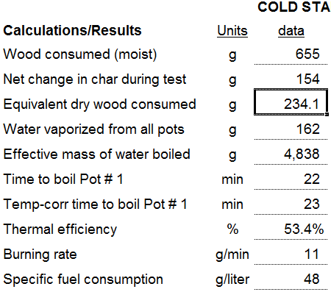
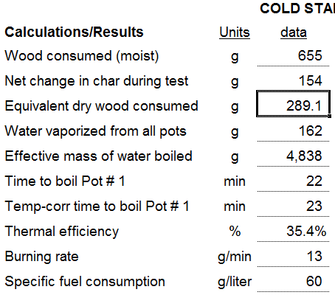
Differences in Concepts, Metrics and Computations
WBT 4.1.2
First Principles View
Formula correction of Dry Mass of fuel
This stove drops from Tier 4 to Tier 3
WBT Version used to create IWA Tiers
Difference: Equivalent dry wood consumed was under-reported by 19% of value

Slide 14
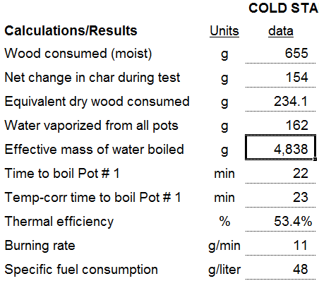
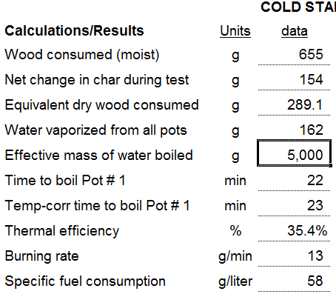
Differences in Concepts, Metrics and Computations
WBT 4.1.2
First Principles View
WBT Version used to create IWA Tiers
Formula correction, Mass of water boiled
Difference: Mass of water was under-reported by 3.2% of value, no change in Tier.

Slide 15
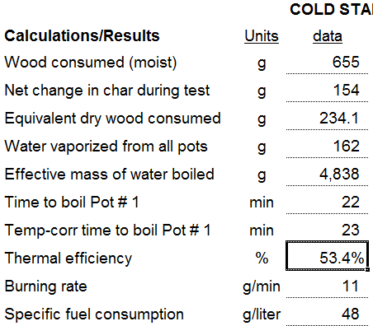
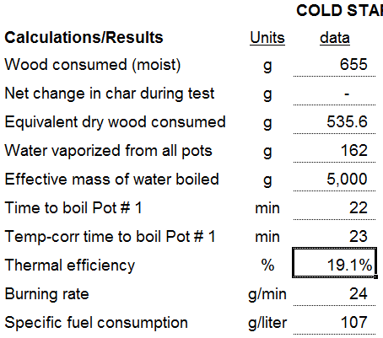
Differences in Concepts, Metrics and Computations
WBT 4.1.2
First Principles View
Concept correction for char remaining which it cannot burn. Drops to Tier 0.
WBT Version used to create IWA Tiers
Difference: Thermal efficiency was over-reported by 280% of value. Burning rate and Specific fuel consumption are now incorrect. Should be 13 & 58 respectively.

Slide 16
The Results Based Financing Model
Results Based Financing is becoming popular and requires an updated approach to testing
Confirmation of performance is conducted in or near the point of stove use
The value of the financial support is based on actual performance and continuous use by the owner
The performance test must correctly assess the relative performance of the product against a baseline product using culturally appropriate cooking and heating cycles.
Many countries have a diverse population, a range of climate zones and a wide selection of stoves. All products must be accommodated fairly.

Slide 17
The Results Based Financing Model
Results Based Financing requires an updated approach to testing
The test methods must use representative pots, burning and cooking cycles in each region
The protocol should specify tasks which are appropriate and representative of actual use in that region.
The metrics used for each section of a cycle must be valid scientifically and culturally for that cycle.
The definitions of each important term should conform to standard scientific usage. Undefined terms like ‘simmering’ or its current substitute ‘Low Power’ should not be used.

Slide 18
The Stove Testing Toolbox
A new First Principles approach to testing stove performance
A social science team visits a target region and observes the representative burn cycles or stove work tasks burning and cooking cycles.
The cycles are characterised with the help of test experts.
The stove operation is divided into characteristic cycles of power and duration for example, boiling water, stir frying, steaming, fast frying cooking with small amounts of oil etc.
A package of tests is conducted in the region on the baseline stoves and the candidate technologies using the burning and cooking cycles common in that area.

Slide 19
The Stove Testing Toolbox
A new First Principles approach to testing stove performance
Each of the tests is conducted according to a standardised set of methods - tools - which have been published in the National Standard.
The ‘tool’ applied for each characteristic cooking task is packaged separately with the procedures given, the measurements to be made and the reporting metrics stated. All calculations are standardised to facilitate valid comparisons.
The tools can be validated separately and updated when necessary. New tools can be published for particular tasks without re-writing the Standard.

Slide 20
The Stove Testing Toolbox
A new First Principles approach to testing stove performance
The Toolbox is a valid set of standardised components which are applied only if they are relevant in the target region.
A metric can only be reported for a whole test if all the tools contain that particular metric.
Space heating can be determined simultaneously or separately with ease using the Siegert Formula because the stove is inside the heating envelope. When it is not (as with hydronic heaters) the China National Standard is appropriate because it covers heating and cooking.
An international standard can be created using this same approach so that culturally appropriate and scientifically valid comparative testing can be done world-wide.

Slide 21
The Stove Testing Toolbox
A new First Principles approach to testing stove performance
The toolbox method does not imply a different protocol for each cooking task. It does not imply a different protocol for each stove type. It implies a set of validated and standardised sub-protocols that are intelligently applied in the location of interest.
A different testing centre, replicating the same set of sub-tests using the same stove, should get the same result allowing for independent confirmation of results. This provides a way to certify the skill of testing laboratory staff.

Slide 22
The Stove Testing Toolbox
A new First Principles approach to testing stove performance
Because the improved stove test result is reported relative to a baseline product and not rated against an absolute standard value, the cost and complexity of the testing centre is significantly reduced.
The precision gained by a certification laboratory is more than lost by using test that do not represent a culturally valid cooking task or burning cycle.
The Stove Testing Toolbox offer better comparisons with less equipment and complexity.

Slide 23
The Stove Testing Toolbox
A new First Principles approach to testing stove performance
A national certification laboratory is still required for other aspects of stove evaluation including safety, durability, combustion efficiency across a range of power levels, water heating ability (boilers), design drift, gas-tightness and so on.
The tools in the stove testing toolbox are designed, discussed and validated by the national certification laboratory then approved by the National Standards Administration.
In-service training provided by the national laboratory ensures that the testing remains up-to-date and is based on current thinking. Important discoveries are shared at the international level through publications and membership on international bodies.

Slide 24
The Stove Testing Toolbox
A new First Principles approach to testing stove performance
It is realised that the toolbox approach is very different from previous methods of the past that specified fixed tasks and procedures.
The toolbox does not specify a standard task because what people do in one region is not the same as in other regions. It does specify exactly how each portion of a test will be conducted and how it shall be reported, added together and rated. A WBT would be a set of three tools run as a single cooking event.
Stoves are assessed by measuring how well they perform relative to each other performing scientifically and culturally validated tasks. At the same time, the methodology provides the outputs necessary to meet international standards as they are now envisaged.

Slide 25
The Stove Testing Toolbox
A new First Principles approach to testing stove performance
This proposal is made with the understanding that it is an approach that requires ‘soft’ and ‘hard’ scientists – sociologists and physical scientists – to work together to understand stove performance.
It places the customer’s needs firmly at the centre of the evaluation process as a user (or abuser) of each stove product. In the case of a Results Based Finance scenario, if they are not happy with the performance they will not use the product and the market aggregator will not be paid their subsidy. This approach protects the promoting agency.

Slide 26
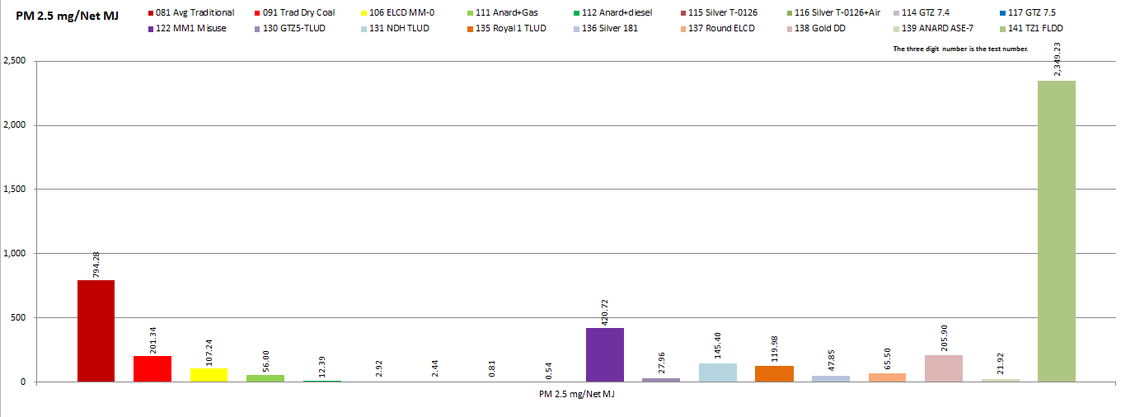
The Stove Testing Toolbox
The First Principles approach to stove development: PM 2.5 change
Using this First Principles approach combined with the local burn cycles in a WB and ADB-supported project resulted in the development of dramatically improved coal stoves as shown below. The baseline stove is the Red column on the left. The Green one was claimed to be ‘improved’. Two products were 99% improved over baseline.

Slide 27
The Stove Testing Toolbox
Thank you for your attention.
Crispin Pemberton-Pigott
crispin@newdawn.sz
SeTAR Centre
University of Johannesburg
South Africa

